Slide 1

Machine Learning

Slide 2
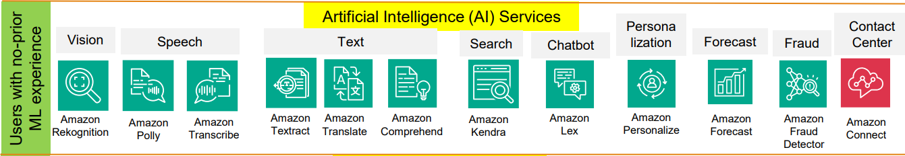
ML Services

Slide 3
Amazon Comprehend
Amazon Comprehend is a natural language processing (NLP) service that uses machine learning to find insights and relationships in text.
Understands how positive or negative the text is
Analyze customer interactions (emails) to find what leads to a positive or negative experience
Use it to identify the language of the text, extract key phrases, understand sentiment about products or services, and find relevant topics from a library of documents.
The source of this text could be social media feeds, web pages, emails, or articles.
Order product from amazon.in and my feedback is -ve

Slide 4
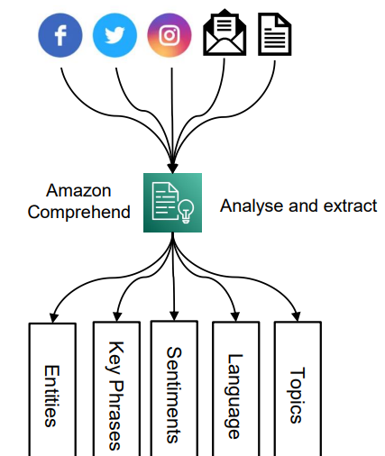
Amazon Comprehend

Slide 5
Amazon Kendra
Fully managed document/intelligent search service powered by Machine Learning
Employees and customers can find the content they’re looking for from multiple locations and content repositories within your organization.
Easy access to the Data
Extract answers from within a document (text, pdf, HTML, PowerPoint, MS Word, FAQs…)
Ability to manually fine-tune search results (importance of data, freshness, custom, …)
Use Case :- Customer-facing websites, Call center, agent assist, Chatbots

Slide 6
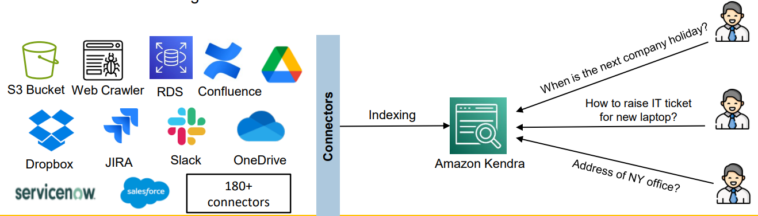
Amazon Kendra

Slide 7
Amazon Lex
Building conversational interfaces for applications using voice and text.
Advanced Natural Language model to design, build, test and deploy conversational chatbot.
Helps build chatbots, call center bots (Lex allows developers to create generic text or voice-based chatbots.)
Integrate AI into applications
Use cases:
Contact centers
Virtual contact center agent

Slide 8
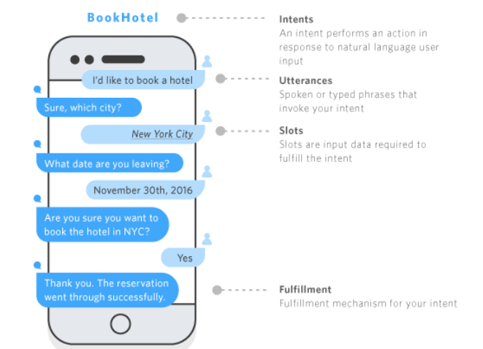
Amazon Lex

Slide 9
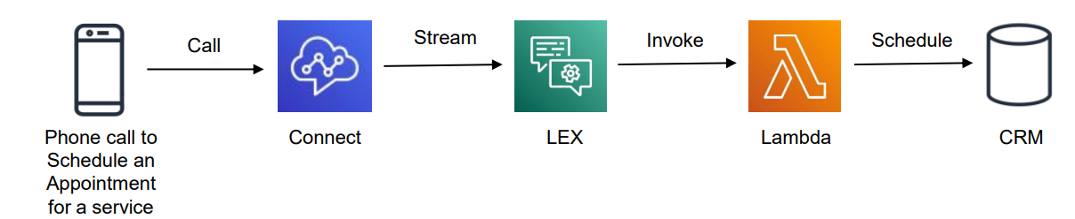
Amazon Connect
Receive calls, create contact flows, cloud-based virtual contact center
Can integrate with other CRM systems or AWS
Contact Centre as a Service
Handles voice and chat

Slide 10
Amazon Polly
Turn text into lifelike speech using deep learning
Allowing you to create applications that talk
Use SSML Language
AWS Documents

Slide 11
Amazon Rekognition
Identify people, text , objects , activities , content moderation , face detection and analysis
Use cases:
Labeling , Content Moderation, Text Detection
Face Detection and Analysis (gender, age range, emotions…)
Face Search and Verification, Celebrity Recognition, Pathing (ex: for sports game analysis)
https://aws.amazon.com/rekognition/
Attendance , unlocking the screen of Mobile

Slide 12
Amazon Rekognition
Celebrity recognition
Face compare and search
Face detection and analysis
Content moderation
Detect objects, Brand logos, Texts
Video segment detection (blank frames etc.)
Easy filtering of video for explicit and suggestive content

Slide 13
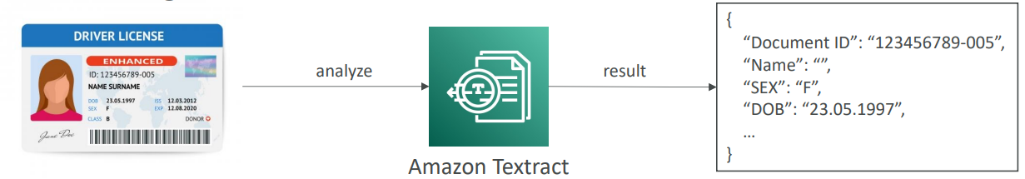
Amazon Textract
Automatically extracts text, handwriting, and data from any scanned documents using AI and ML
Extract data from forms and tables
Read and process any type of document (PDFs, images, …)
Financial Services (e.g., invoices, financial reports)
Healthcare (e.g., medical records, insurance claims)
Public Sector (e.g., tax forms, ID documents, passports)

Slide 14
Amazon Transcribe
Automatically convert speech to text
Uses a deep learning process called automatic speech recognition (ASR) to convert speech to text quickly and accurately
Automatically remove Personally Identifiable Information (PII) using Redaction
Supports Automatic Language Identification for multi-lingual audio
Transcribe customer service calls & automate closed captioning and subtitling Ex – MS Teams , Movie Subtitles

Slide 15
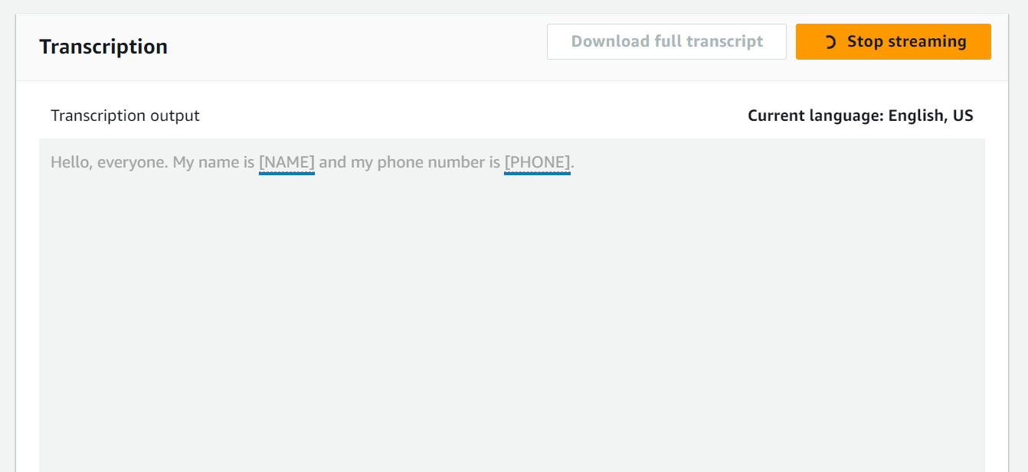
Amazon Transcribe

Slide 16
Amazon Translate
Natural and accurate language translation
Amazon Translate allows you to localize content - such as websites and applications - for international users, and to easily translate large volumes of text efficiently

Slide 17
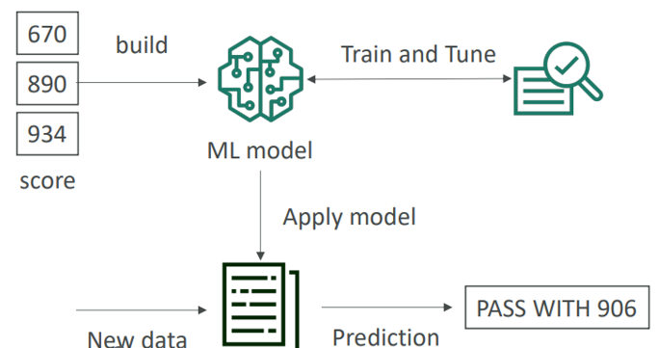
Amazon SageMaker
Fully managed service for developers / data scientists to build ML models (Fully Managed ML Service)
Machine learning process (simplified): predicting your exam score

Slide 18
Amazon SageMaker
Use Cases
Create models for preventative maintenance, which analyse sensor data to find equipment defects before they happen.
Bank Transactions to RBI
financial forecasting, demand prediction, and more.
Prescribe the medicines

Slide 19
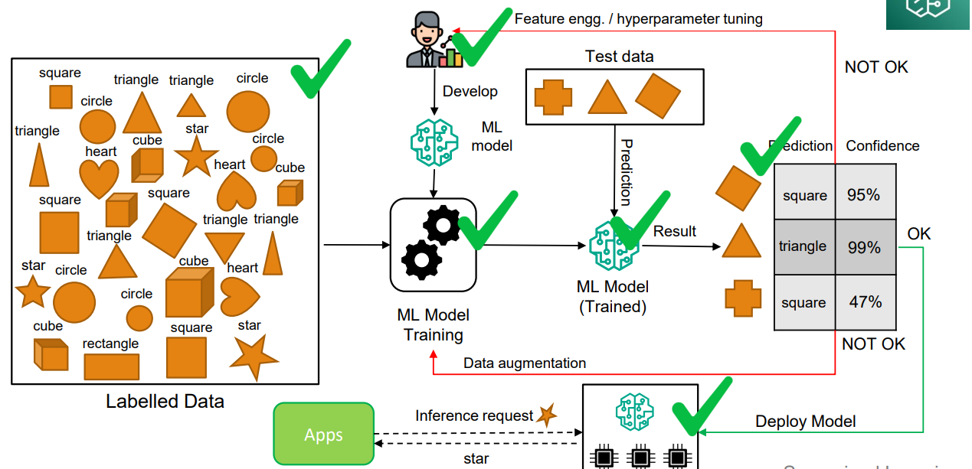
Amazon SageMaker

Slide 20
Amazon SES
Amazon Simple Email Service (SES) allows you to send and receive emails using your email addresses and domains at a low cost and with high scalability.
You can use SES to send marketing emails.
It eliminates the need to manage your email servers

Slide 21
Amazon Fraud Detector
Detect online fraud faster with machine learning.
Build, deploy, and manage fraud detection models without previous machine learning (ML) experience.
Use cases: Identify suspicious online payment, Detect new account fraud, Prevent loyalty program abuse, compromised accounts etc.

Slide 22
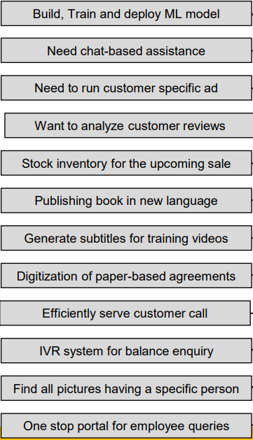
QnA

Slide 23
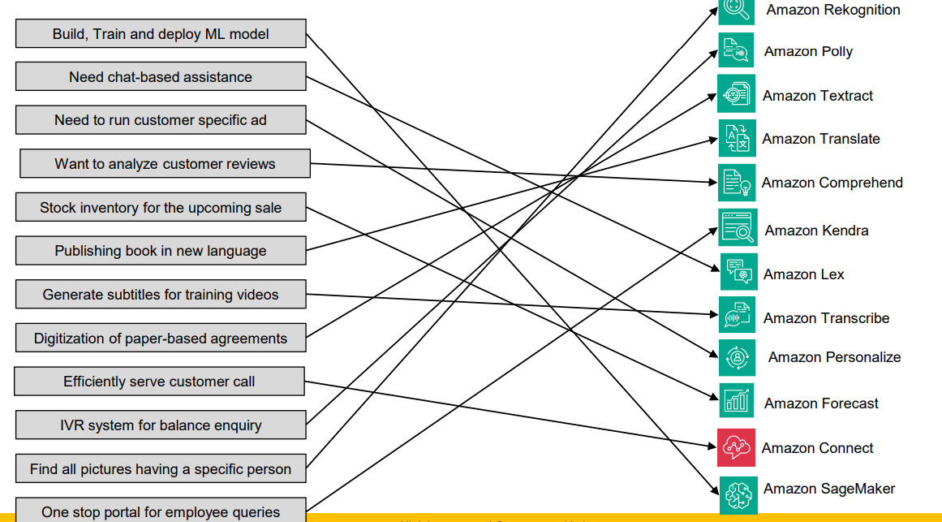
Answers

